Slide 1
Data Exploration and Modeling

Slide 2
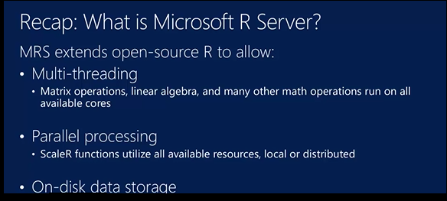

Slide 3
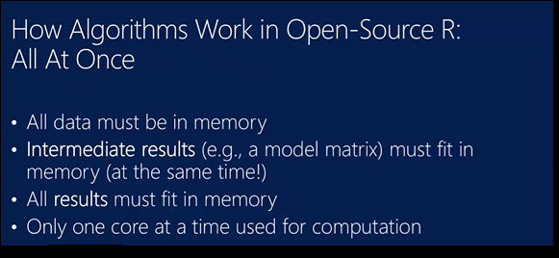

Slide 4
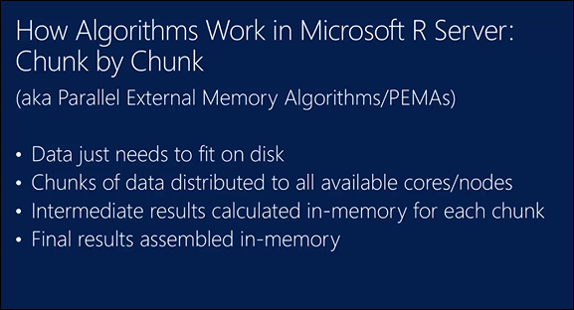

Slide 5
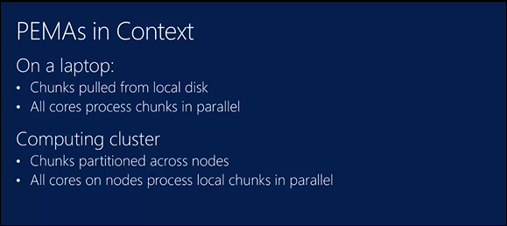

Slide 6
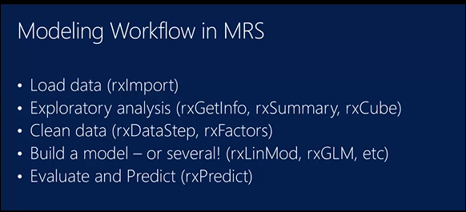
THE MODELING PROCESS in MRS

Slide 7
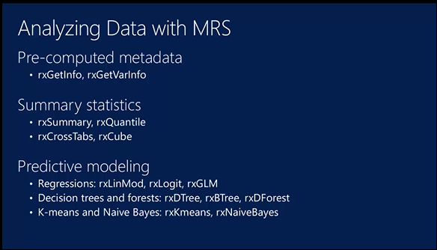
Deep Learning and Neural Nets :rxNeuralnet

Slide 8
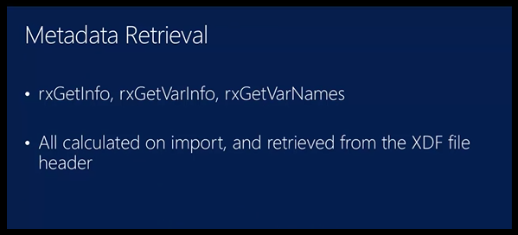

Slide 9
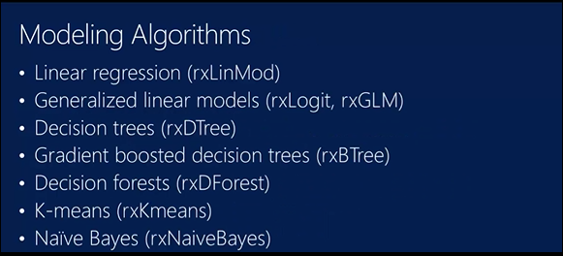

Slide 10
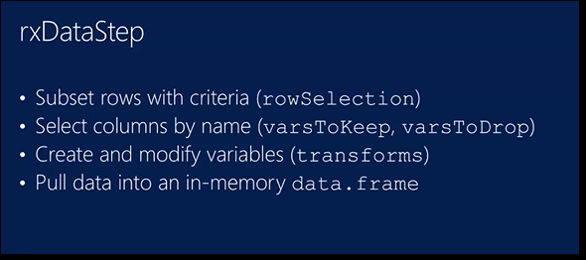

Slide 11
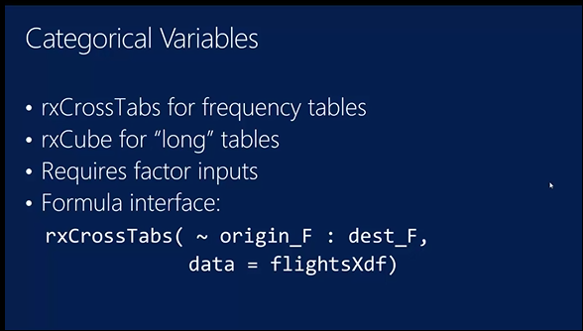

Slide 12
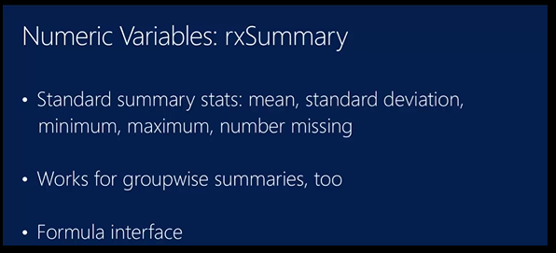

Slide 13
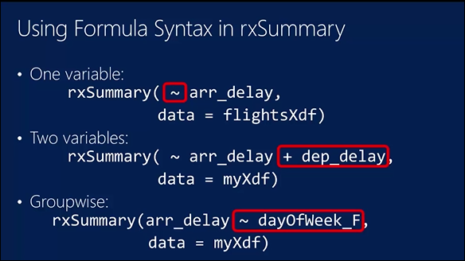

Slide 14
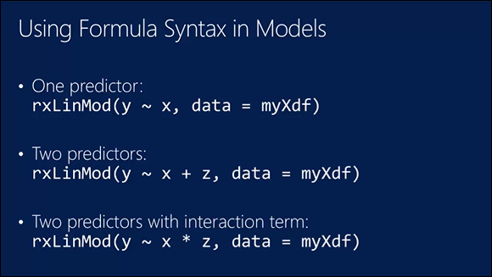

Slide 15
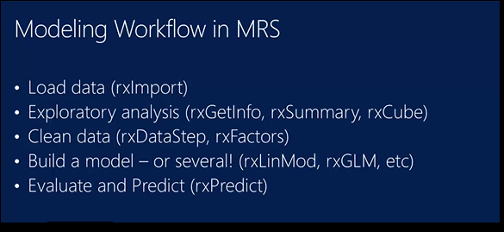

Slide 16
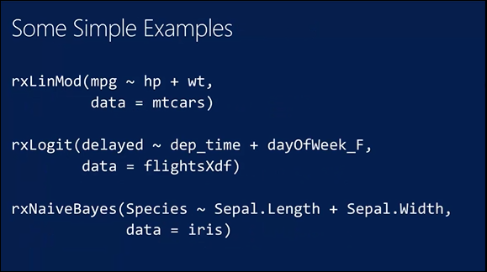

Slide 17
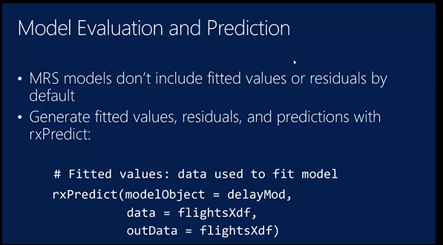

Slide 18
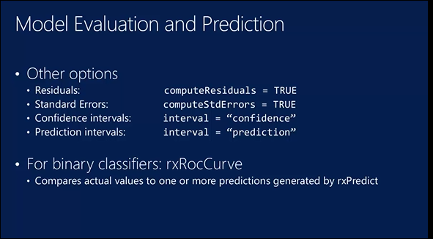

Slide 19
THE FLOW WE WILL FOLLOW

Slide 20
Teacher’s lecture R scripts
Three R script files that is used to lead discussions students can use this also for exercise.
Part 1 – “Data Ingestion Exercises in MRS.R”
Part 2 – “Exploration and Modeling”.R in MRS

Slide 21
Exercises:
Elementary Exercises: Guided
https://msdn.microsoft.com/en-us/microsoft-r/scaler-getting-started -
Medium Exercises https://github.com/Microsoft/MRSWorkshopStudent/blob/master/Labs/3_MRS_Analysis_with_Solutions.R
Intermediate Exercises -go to directory:
C:\Program Files\Microsoft\R Server\R_SERVER\library\RevoScaleR\demoScripts - MRS
C:\Program Files\Microsoft\R Server\R_SERVER\library\MicrosoftML\demoScripts – for RML
https://msdn.microsoft.com/en-us/microsoft-r/data-analysis-in-microsoft-r

